Slide 1

Change Readiness &
Organizational Change

Slide 2
Welcome & Introductions
~Name
~The word that
describes me
most is ____ because ____.
Resourceful
Passionate
Optimistic
Adventurous
Resilient
Tolerant of Ambiguity
Flexible
Notes:
12:00-12:10
Hi everyone, I’m Jacyn and I’ll be leading the workshop today…
A little bit about who I am… Of all the words on the screen, the one that describes me MOST is ________.
Please share your name and the trait that describes you MOST...

Slide 3
Outcome:
I can build the self awareness & organizational awareness to become more adaptive during a transition or become a change leader in my organization.
Notes:
12:10-12:11

Slide 4
Expectations
Notes:
12:11-12:14
We expect you to participate in the discussion and be thoughtful in your reflections. Reflection is extremely important as transitions take place internally when change occurs externally. When I give you the opportunity to write down your thoughts and ideas - take your time, think, and I’ll give you space to write.
At the end of the workshop you will be given over an hour to apply the Readiness Factors or the 8 Stages of Organizational Change at your company, and at the very end of the day you’ll share with the group how you uniquely solve a change situation at your company.

Slide 5
Agenda
Intros & Outcomes
Personal Transition Curve
Eight Change Readiness Factors
Eight Stages of Organizational Change
Organizational Change at Your Company
Notes:
12:14-12:15

Slide 6
Intro
Notes:
Alright, what happens to individuals when change happens in an organization?

Slide 7
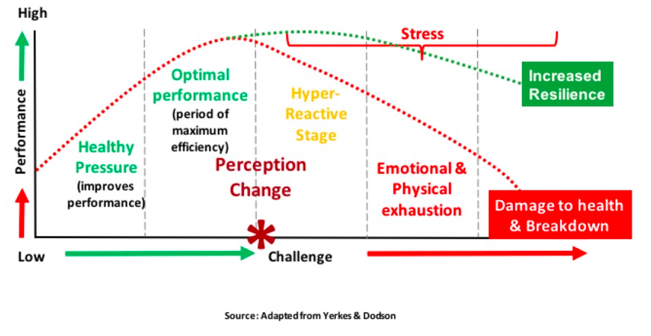
Notes:
12:15-12:16
Jacyn says:
So, the one thing we all know about change and that is that it can be stressful.
Take a moment and take in this graph. (Actually give them 10 seconds in complete silence)
We need just the right amount of stress to achieve optimal performance. The level of stress is determined by both your challenges and competencies. There is a fine line between two much challenge and just enough to create optimal performance with out falling into the “stress” zone. Periods of change and transition often test that boundary, often pushing us farther to the right. So how do can we best prepare?
NO DISCUSSION ON THIS SLIDE. SHORT AND SWEET.

Slide 8
Interviewee’s name:_______
Situation Summary:___________________
_________________________________
Negative Reactions to Change
1.
2.
3.
etc.
Positive Reactions to Change
1.
2.
3.
etc.
Notes:
12:16-12:26 [Explain the instructions slowly, carefully, & in order]
Take a moment to think of a change that happened in your life recently – It can be personal or professional.
In a moment, you will be interviewed by the situation by a colleague. You will both get to be the interviewer and the interviewee.
When you are interviewing, please write down the other person’s change situation - just a sentence or two. Please ask them questions to find out about both their negative and positive reactions to the change. You will have ~5 minutes to conduct your interviews AND take notes, and then we will switch.
Don’t get in pairs yet. Go ahead and take a moment to think about the situation you feel comfortable sharing. (Point to the slide and actually pause in silence. Make eye contact around the room.)
Have a space to write down the summary as well as the negative and positive reactions.
Now, find a partner and pick who will be the interviewer and interviewee. Your three minutes will begin shortly. Get started.

Slide 9
Interviewee’s name:_______
Situation Summary:___________________
_________________________________
Negative Reactions to Change
1.
2.
3.
etc.
Positive Reactions to Change
1.
2.
3.
etc.
Notes:
12:26-12:30
Gather everyone’s attention.
Thank you - would 2 interviewers briefly present their interviewee’s situation. (THIS IS NOT TIME FOR DISCUSSION. SELECT 2 PEOPLE TO BRIEFLY SHARE.)

Slide 10
Transition Curve
Notes:
Alright, thinking about the two examples we just hear. Where would they fall today on the transition curve? Where would your own story fall? Let’s take a look.

Slide 11
Personal Transition Curve
Happiness
Moving Forward
HIGH
Denial
Disillusionment
Acceptance
Fear
Anxiety
Gradual Acceptance
Threat
Hostility
Guilt
LOW
Depression
Time
Notes:
12:30-12:35
Alright, thinking about the two examples we just hear. Take a moment and look at the diagram. Think about where would they fall today on this personal transition curve? Where would your own story fall?
(Ask directly of those whose stories we heard from as well)
Does reaction to change matter?
The Personal Transition Curve is a great tool in recognising what is needed at each stage. As a manager who is leading the change, you need to be aware that most people may not clearly understand which part of the curve they are in. It is your job to recognise this, communicate appropriate information and provide support to help them through these stages.
As you may have noticed, many of the stages on the transition curve are highly emotional. Management must take steps to address these emotional upheavals as they occur and control their impact in order to minimise the spread of negativity throughout the organisation.
Does everyone go through the transition at the same speed?
No. Different people transit through the curve at different speeds. Hence, you will end up with a team where each person thinks slightly differently about the change and hence behaves differently. This is why the management needs to provide a tailored solution to accommodate various needs and reassure the staff accordingly.
How might you use this tool at your company with the employees you manage? How might you use it at a meeting? This is one of your options as a tool to implement, so keep it in the back of your mind as we dive into Change Readiness Factors and more.

Slide 12
What makes a change seem positive?
Negative? Why?
Why do you think it is important to become more effective in how we perceive and react to change around us?
How might you share the “personal transition curve” as a tool at your company with your employees?
Notes:
12:35-12:40
Before we move on to the 8 Readiness Factors, please take a moment to reflect on these questions. Write down a thought down an idea for each of the questions.
[3 entire minutes of silence for writing]
[Make a final comment and then move on…]
Can you see how any kind of change may be perceived as good or bad and is often a little of both.
Hopefully from your writing and answers to these questions, you can see how any change that happens to you has both good and bad aspects. It is important to appreciate this as it will keep you open minded and learning through even your most difficult changes

Slide 13
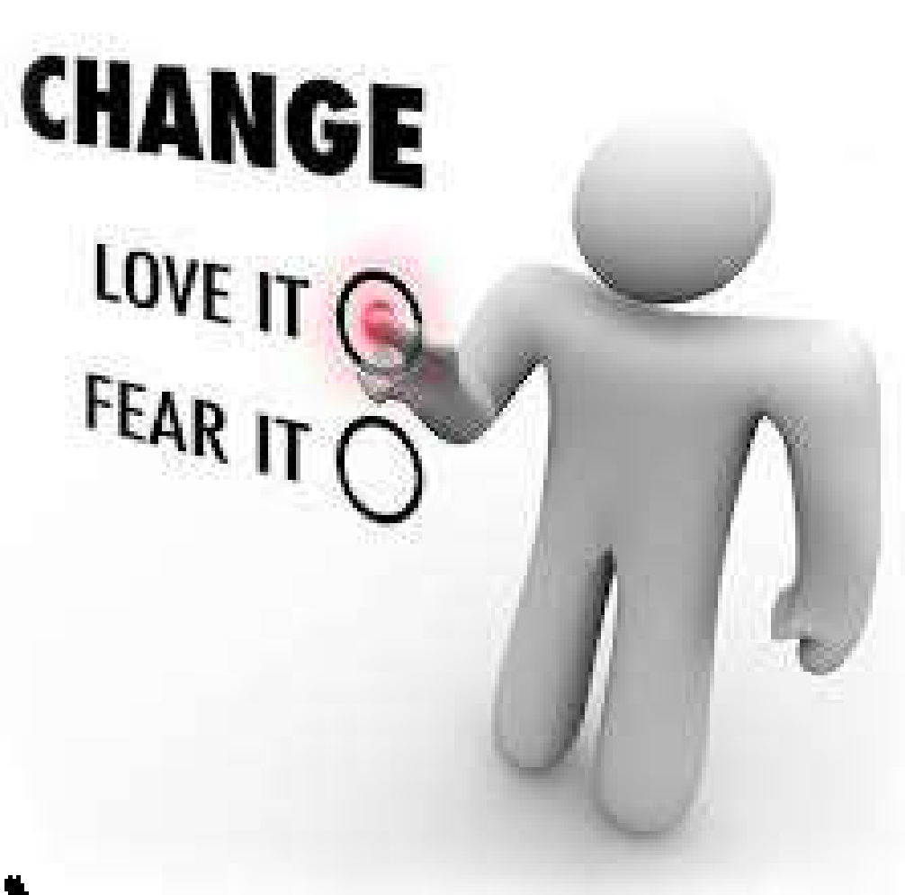
Change Readiness for Individuals & Teams
“Change Ability: Ready or Not?”
Notes:
12:40-12:50
Jacyn Says:
“Each and every organization and individual must undergo change to grow and thrive. It is our unique change readiness traits – also referred to as the ‘8 Factors of Change Readiness’ that impact the way we perceive and react to this change in our professional and personal lives.
In a moment, I will give you an article to read individually by Jean Larson about these 8 traits.
Whether you are in a leadership role or part of a team, these 8 factors influence your ability to embrace and adapt to change. They also indicate your current abilities to act as part of a cohesive team with a shared goal, vision, and mission.
In a team environment, the individual traits of each member determine their ability to complement one another’s strengths and weaknesses, and can personally impact whether you are seen as a forward thinking thought leader and valuable change agent within your organization.
[Jacyn hands out reading and gives explicit instructions]
Please read at your own pace - if you finish quickly there will be questions for you to reflect on up on the slides. We will come together after the reading for a discussion OF EACH TRAIT.

Slide 14

Reflection Questions
How do you believe you feel about change compared to your colleagues? Family members?
Are you more open to change in your life than others are? Or less so?
Is your openness to change different in your professional life versus your personal life?
Why or why not?
Notes:
12:50-12:55
Jacyn Gives Instructions:
“Turn to a colleague and take 2 minutes to reflect on the following questions:
How do you believe you feel about change compared to your colleagues? Family members?
Are you more open to change in your life than others are?
Is your openness to change different in your professional life versus your personal life?
Why or why not?”

Slide 15

Reflection Questions
Before we dive into the 8 factors, take a moment to reflect on recent changes occurring in your organization.
What factors made these changes seem positive or negative for you personally or for your team?
Notes:
12:55-1:00
Jacyn says:
Before we dive into the 8 factors, take a moment to reflect on recent changes occurring in your organization.
What factors made these changes seem positive or negative for you personally or for your team?
Take out your journal and your pen and and write down an example as well as the positive and negative factors.
[Time is given to write]

Slide 16

Adventurousness
Notes:
1:00-1:03
Jacyn Says:
How many of you think this is one of your top traits from the list? (Ask for raised hands)
Who would describe their organization as adventurous? (Ask for raised hands)
What about your coworkers?
[Briefly go over some points about the trait ~1 minute]
Do you have a sense of adventure?
Two ingredients capture the adventurous spirit: the inclination to take risks, and the desire to pursue the unknown; to walk the path less taken. Adventurous people love a challenge.
Being highly adventurous indicates that you may frequently ask, “why not?” when it comes to taking risks or exploring new options. You are often the ideas person and innovator on the team. You’re exhilarated by trying new things. However, if you are perceived to be too adventurous, it may indicate that you have a tendency toward recklessness. Others may fear that you enjoy risk for risk’s sake, and you seek out new experiences just for the thrill of it.
A moderate sense of adventure indicates that you usually perform well during organizational shake-ups, since change always involves both risk and the unknown. You are seen as being proactive- as a person who can confidently initiate and create change.
Having a low sense of adventure indicates that you are very risk-averse and do not like to try new things. You may be suspicious of anyone suggesting a new way of doing things, or suggesting that you personally try something new.
What about Teams?
Adventurous Teams
It is best to enter into a team environment with a “we can do this” attitude. Team members with a healthy sense of adventure are easily able to learn through the process of “doing” and adapt more easily to change. Team members with a good sense of adventure can be infectious to others and give the team energy, just as those with a low sense of adventure can negatively impact the team. In the face of change, make a commitment with your team to figure things out for the greater good, and let those who score higher on this particular factor motivate those who score lower in the face of change.

Slide 17
The Adventurous Leader
Notes:
1:03-1:05
How does Adventurous Leadership look?
Successful leaders often exhibit a healthy sense of adventure, no matter how challenging or difficult the task at hand is. However, a leader should not be too adventurous, where the “adventure” could be perceived as thoughtless frolic by your team. Leaders who score high in the Adventure and Confidence index must also learn to be vulnerable with their team, and take a back seat in areas where they think they know the most. You want to be open to other ideas and recognize that others on your team may have other creative ideas. Don’t let your sense of adventure stop you from taking others’ opinions into account.

Slide 18

Optimism
Notes:
1:05-1:07
Jacyn Says:
How many of you think this is one of your top traits from the list? (Ask for raised hands)
Who would describe their organization as adventurous? (Ask for raised hands)
What about your coworkers?
[Briefly go over some points about the trait ~1 minute]
Is the glass half empty or half full? Optimism is highly correlated with change readiness, since the optimist recognizes opportunities and possibilities, while the pessimist sees only the problems and obstacles.
Being highly optimistic indicates that you believe that things always work out and you find encouragement and hope in every situation. However, if you are seen as too optimistic, your team may wonder if you lack critical-thinking skills. You want to avoid being considered someone who is blindly optimistic about every situation by your colleagues.
Being moderately optimistic indicates that you are optimistic in general. However, there are times when you focus on the negative aspects of a situation, and may become overly cautious, pessimistic, or even fearful.
Being less optimistic indicates that you are the one who can easily see the possibilities of a bad outcome in any situation. You may be perceived as overly cautious, fearful, and negative; and risk overlooking valuable opportunities.
Optimistic Teams
In a similar fashion, team members who are too optimistic often leave problems to work themselves out, while those who are too pessimistic are quick to believe that obstacles cannot be overcome. Team members who are too optimistic may have unrealistic expectations for the time and effort required to complete a project, while those who are too pessimistic will have difficulty getting a project off the ground or attempting to solve a problem. For ideal teams you’d like people who score along the entire scale of the optimism factor – both high and low. You can complement each other. And this variability of optimism often leads to the best plans – those that are both creative but yet plan for all contingencies

Slide 19
Optimistic Leaders
Notes:
1:07-1:08
[Briefly go over some points about the trait ~1 minute]
Being optimistic is very important when we are leading a change initiative. Once again, your team is going to be watching you closely. In fact, your reactions and actions are probably more important than any of the words coming out of your mouth. You can say you are optimistic, but if you don’t act like it, nobody is going to buy into the initiative or want to follow you.

Slide 20

Confidence
Notes:
1:08-1:10
If optimism is the view that a situation will work out, confidence is the belief in your own ability to handle it and make it so. Self-Confidence is the belief that, “I can handle whatever comes down the pike.”
A high level of confidence indicates that you are an individual with a strong sense of self-esteem. You believe that you can make any situation work for you. However, if your confidence is too high, you may be perceived as someone who already thinks they know everything, who is not open to feedback. You could even come across as arrogant and unapproachable.
A moderate level indicates that you have a good level of self-confidence, without being overly-confident. You can handle most situations that come along, however there are times when your confidence may waiver. This could be when you are in unfamiliar territory or facing situations that are similar to ones you have had trouble with in your past.
A low level of confidence indicates that you may be lacking in self-esteem, and have a lot of self-doubt in your abilities. The only picture of change that you can envision is one that brings bad news and more difficulties into the your personal and professional life.

Slide 21
The Confident Leader
Notes:
1:10-1:11
What about Confident Leadership?
A leader must be confident that he or she can lead the team from Point A to Point B. Change can cause fears to arise in your team, and if it is perceived that the leader is not confident, this almost immediately impacts the rest of the team. Exude confidence in yourself and your team’s abilities, and inspire those around you to embrace change and uncertainty.

Slide 22

Passion
Notes:
1:11-1:12
Passion is the fuel that energizes all the other traits. If you have passion, nothing seems impossible. On the other hand, if you don’t have passion, change can seem overwhelming and exhausting. Passion is your level of personal drive. It shows up in your level of intensity and determination. Your passion helps propel you forward to get things done. To make a new procedure work, to overcome the myriad of problems that any plan for change may produce, you must have passion, enthusiasm, and drive.
A high level of passion can help you move through even the most challenging and difficult changes, even when others doubt it can be done. However, if you are highly passionate, you may come across as somewhat pushy, bullheaded, and stubborn. You may also be at risk of burning out, and at times, you may not be able to see or find other ways around obstacles.
Having a moderate level of passion indicates that you do have passion toward certain aspects of your life, and when you are interested or fully engaged in things you love, you will show energy, drive, and determination. However, when you are not interested in the situation at hand, you may not exert the same level of energy and enthusiasm.
If you lack passion, you may come across as lacking in drive, energy or the ability to get difficult tasks done. You may give up too easily when a bit more perseverance would help you be more effective
So what about teams and passion?
In any organization, there will be ugly meetings and frustrating projects. A team must be able to feed off of each other’s passion and energy to achieve a goal. The level of commitment within a team can be determined by the level of passion for a particular project. Passion helps us get through the tedious or boring parts of projects and ultimately helps us to persevere. Look to the more passionate members on your team to provide the fuel to move you toward your most challenging goals.

Slide 23
The Passionate Leader
Notes:
1:12-1:13
Passionate Leadership
Passion indicates your level of energy and commitment to seeing something through. Passion is the fuel that propels you, your business, and your team forward in the face of long days, long nights, and inevitable setbacks. A leader who is passionate about the team’s mission can inspire the team to achieve much more than they think is possible. Change can be exhausting, and the ability to persevere requires a passionate leader.

Slide 24

Flexibility
Notes:
1:13-1:14
The first factor of change readiness is Flexibility - Are You Flexible When Change Happens? –
Flexible people have goals and dreams like everyone else, but they’re not overly invested in the details of how they achieve those goals. When something doesn’t work out, they’ll say, “If Plan A doesn’t work, let’s go to Plan B.”
If you are very flexible, you are not wedded to specific outcomes. You are able to generally take things in stride. If the situation changes, your expectations shift right along with it. However, being perceived as highly flexible may indicate, or project to others, that you lack commitment or the ability to stick with a difficult task over time.
If you are moderately flexible, it means that at times you are flexible and able to make changes or adjustments as required by changing circumstances. There will also be other times where you take a more rigid stance and stand firm. This may be because you do not understand the need to change, or it may conflict with your values or way of doing things.
If you are not flexible at all, you can be very set in your ways and do not like it when goals or expectations change. You may seem to even take more time than others to process and understand the changes going on around you. In the end, you want to be flexible enough to be able to change your perspective when appropriate, while not being so inflexible that you refuse to do anything different.
So what about TEAMS?
When working as part of a team, it is important to stay focused on your goals and objectives, while remaining flexible and open to possible change. You may come into a team with your own perceptions of how to solve a problem, but it’s important to realize there are other perspectives in the group, and multiple ways of solving problems. Be careful not to jump too quickly to a solution before hearing everyone out. Team members who are too inflexible often risk “checking out” when their ideas aren’t chosen, which can be extremely harmful to the team. On the opposite end of the scale, you must also be wary of being perceived as too flexible, or the rest of your team may wonder if you are truly engaged with what the team is working on.
[END OF MODULE REFLECTION QUESTIONS]

Slide 25
Flexible Leadership
Notes:
1:14-1:15
Flexible Leadership – What about when you are the leader?
Both extremes of flexibility – being too flexible or being inflexible - are magnified in a leadership role. It could be perceived that leaders who are too flexible do not fully understand the issues at hand, or that they can be easily swayed. If too inflexible, it could also come across as if the leader does not appreciate the impact on his team’s work life during change or transition periods. There may be times where you need to be extremely flexible, taking time to listen to opinions with careful patience. For a leader especially, there will be other times when change comes quickly, and you will need to make a top-down decisions, requiring less flexibility. Unfortunately there is no one way – you must use your judgement and tap into the resources of those with a different flexibility profile if needed.

Slide 26

Tolerance for Ambiguity
Notes:
1:15-1:16
Next is tolerance for ambiguity:
The one certainty surrounding change is that it causes a lot of uncertainty. No matter how carefully you plan it; there is always an element of indefiniteness or ambiguity. Without a healthy tolerance for ambiguity, change is not only uncomfortable; it’s downright scary.
A high tolerance for ambiguity means that, though not everything is defined or under your control, it does not threaten or frighten you. If you have too much tolerance for ambiguity it can also get you into trouble. Why? You may have difficulty pinning people and situations down if you are too comfortable with fuzzy situations. Also, your comfort with ambiguity can make some of your team mates who are less tolerant of ambiguity VERY uncomfortable.
A moderate ability to tolerate uncertainty or ambiguity means that you tolerate ambiguity fairly well, but at times may feel uncomfortable when a situation arises and you don’t know what is coming next or what the impact will be. You will either try to gather more details to clear things up, or work through it as best you can.
If you have a low tolerance for ambiguity you may tend to feel that any kind of change, new direction, or idea, seems threatening and scary. You may feel out of control and uncomfortable with the fact that you feel you don’t know what is going to happen next and how it will impact you.

Slide 27
Tolerance for Ambiguity for Leaders
Notes:
1:16-1:17
What about the role of the leader when it comes to Leading Through Ambiguity?
A leader must accept that with change comes a certain level of ambiguity. New initiatives require patience and the ability to instill confidence in your team when things are unclear. It is important to do a self-assessment of your tolerance for ambiguity, and recognize that your team may not be as comfortable as you may be. Uncertain times require added patience, especially when fears in the team arise. Team members must also remain calm and patient with their leader as they are able to provide further detail pertaining to big picture ideas. No matter how well we plan the change initiatives, not every details is available until you begin to move forward into implementation. You will have to help the team understand this.

Slide 28

Resourcefulness
Notes:
1:17-1:19
The next change readiness factor is resourcefulness:
Resourceful people are effective at making the most of any situation and utilizing whatever resources are available to develop plans and contingencies. They see more than one way to achieve a goal, and they are able to look in less obvious places to find help. They have a talent for creating new ways to solve old problems. Some of you may recall an old TV show called “MacGyver” In the show MacGyver was the epitome of resourcefulness. Now matter what difficult situation he found himself in, he was able to use the tools and resources at hand to get out and save the day.
If you are highly resourceful you always find an answer or solution, even when others have given up or tell you that everything has already been tried before and won’t work. However if you are too resourceful, you might have a tendency to overlook obvious approaches or solutions, and make things more difficult and create more work than is necessary.
Being moderately resourceful indicates that you can be resourceful at finding solutions to problems that arise. There may also be times when you may get stuck and decide to give up or stick with the status quo. You may not want to invest your time and energy into finding a solution or better way of doing things.
If you are less resourceful, you may find that when you encounter obstacles, you stop or get stuck, dig in your heels, and go back to the old way. You have a difficult time finding solutions and methods to address new or challenging situations. You may be accused of always seeing the glass as being ½ empty.
What about teams
Resourcefulness for teams – within a team with people who are working effectively together, you can identify your and other’s strengths so that you can draw upon them in times of need – Who on your team is more resourceful? Find them and get to know them. When the team gets stuck and is looking for a way forward, partner with your resourceful team members to find new creative solutions.

Slide 29
Resourceful Leaders
Notes:
1:19-1:20
What does Resourceful Leadership look like?
For those of you in a leadership role, it is critical to realize that you can’t do everything yourself. The team you lead is your best resource for creativity, and a critical factor for success is relying on their support. Resourcefulness forces you to have a big picture perspective of a problem, but it is important not to miss the obvious solutions, over-complicate problems, or take the “long way around.” Make sure that you tap the resources and ideas from your team and be wary of not being resourceful enough, or you may only see one way of doing things, and remain stuck in old habits or ways of doing things.

Slide 30

Resilience
Notes:
1:20-1:21
Last but not least is Resilience It is the quality that allows some people to be knocked down by life’s changes and challenges and yet come back stronger than ever. It is your ability to cope with stress and adversity. If you are resilient, you are more able to bounce back from the setbacks you experience in your life. Resilient people take delays, obstacles, and setbacks in stride, and are able to rebound from adversity quickly with a minimum of trauma. Failure or mistakes do not throw resilient people. They don’t dwell on them or get depressed, they move on.
If you have a high level of resilience, life’s trials and difficulties do not keep you down for long. You are able to move through them and on to better things. However, if you are perceived to be too resilient, people may see you as aloof and unconcerned. And, in some ways, if you are not impacted by your life’s setbacks, you may be less likely to stop, reflect and learn from them.
Being moderately resilient generally means you do not let the trials and difficulties of life keep you down for long. You are able to move through them and on to better things. However, there may still be times when you may feel hit particularly hard when something doesn’t turn out the way you had hoped, and it may take you longer to recover.
If you less resilient, you may feel hit particularly hard when something doesn’t turn out the way you had hoped. It may take you longer to recover, and you may be prone to negative thinking that can cause the adverse outcome to have a stronger and longer impact upon you.

Slide 31
Resilient Leaders
Notes:
1:21-1:22
Resilient Leadership and Teams
Whether you are in a leadership role or part of a team, you need to be individually resilient as well as helping the organization itself become resilient. Remind others, “We got through that tough situation in the past, we can handle the current situation.”

Slide 32
Reflection Questions
Resourcefulness
Tolerance for Ambiguity
Flexibility
Resilience
Passion
Confident
Adventurous
Optimism
How would you rate your resourcefulness on a scale of 1 – 10 with 10 being the highest?
How would you be perceived if you were “too ___<resourceful>_”? Explain with an example.
How would you be perceived if you were “less __<resourceful>__ than others? Explain with an example.
What might be the value of having a team that included team members who were highly resourceful as well as those with less ability to be resourceful?
Notes:
1:22-1:30
Jacyn says:
Pick two traits and answer the following 4 questions for each of them for yourself.
[Give a few minutes of writing time]
After you write your answers for two different traits, share what you wrote with a colleague.
[Give a few minutes of pair-share time]

Slide 33
8 Change Readiness Factors
Adventurous | Flexibility
Optimism | Tolerance for Ambiguity
Confident | Resourcefulness
Passion | Resilience
Notes:
1:30-1:35
Jacyn says:
How many of you picked ___ “optimism”__? {Ask for raised hands, repeat with other factors/traits}
[conclude section]
We all perceive and respond to change differently, and we have different strengths that we can leverage in how we approach change. We’ll begin with a review of the 8 factors of change readiness and begin to understand different ways that you and others may perceive and react to change. These differences will affect how we impact and influence others, and it has a significant impact on our leadership style. As leaders of organizations and teams, one of our most important roles is leading change.
The 8 Factors of Change Readiness help us take a closer look at how we are affected by change, and allow us to more courageously forge the path ahead. At the end of the course, you should have a better feel for your Change Readiness profile and how to leverage your unique traits.
Again, you are strongly encouraged to complete the reflection questions at the end of each factor. To begin, think about how you perceive change and react to it, and think about times when you have reacted differently than your colleagues when a significant change occurred. What are some reasons the reactions were different? Why were they alike?

Slide 34
Time for a break!
Notes:
1:35-1:40

Slide 35
Resistance to Change
EVENT + RESPONSE = OUTCOME

Slide 36
Resistance is driven by Fears
Fear of Reorganisation
Fear of Loss
Fear of Implications
Fear of Uselessness
Fear of Loss of Control
Fear of Direct Change
Fear of Losing Face
Fear of Surprise
Fear of the Unknown
Notes:
1:40-1:50
Jacyn says:
Why do people fear change? [get people to shout out answers]
Jacyn clicks mouse, answers pop up, she says:
Here are a number of reasons why people resist change.
[DISCUSSION]
To Tutor: For each of these ask, “what happens if you let that fear prevail or spread to others?” Expect answers and expand the discussions to highlight the importance of handling each fear.
Fear of reorganisation. Disturbs the status quo and gets people out of their comfort zones.
Fear of loss. Desire not to lose something of value.
Fear of implications. Misunderstanding of the change and its implications. It is effectively fear of “walking off a cliff while blindfolded.”
Fear of uselessness. Belief that the change does not make sense for the organisation.
Fear of loss of control. Change is exciting when it is carried out by us but threatening when it is done to us.
Fear of direct change. Some individuals have low tolerance to change.
Fear of losing face. Belief that by going with the new change, they are accepting that their previous decisions and processes were wrong. They resist change to remain consistent with the past.
Fear of surprise. When change is suddenly announced, most people are so shocked that they would rather resist the change or undermine it than to accept it.
Fear of the unknown. People are afraid of what will happen if they go through change. One of your aims should be to make the status quo appear more dangerous than launching to the unknown.
[DISCUSSION]
Now that you know the fears, how should you deal with resistance to change?
To Tutor: Encourage a discussion on this before moving on to the next slides to explain a variety of techniques that can be employed for this. Your aim here is to let the delegates suggest many of the techniques themselves rather than being told about them. The purpose of the next slides is to structure this technique into a number of concise guidelines.

Slide 37
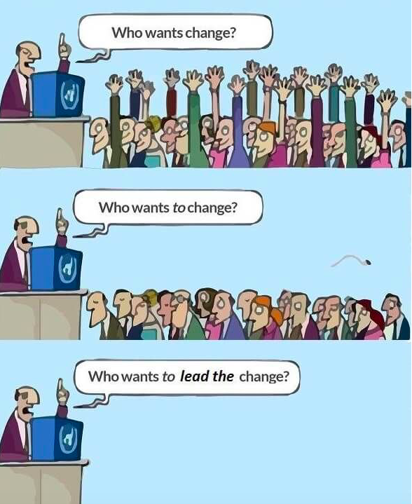

Slide 38

8 Stages of Change
Notes:
1:50-1:52
According to John Kotter, a leading thinker on organisational change, there are 8 stages in creating a major change (Kotter, 1996).
The model helps to structure a change management programme and helps to pay attention to all aspect of it without neglecting some critical parts or thinking that the programme has succeeded when you still need to go through a few more stages.
I’m going to tell a story of an organization going through these changes:

Slide 39
STAGE 1
Establish a Sense of Urgency
STAGE 2
Create a Guiding Team
STAGE 3
Develop and Share a Vision
STAGE 4
Communicate the Vision and Strategy
STAGE 5
Encourage Action
STAGE 6
Produce Short-Term Wins
STAGE 7
Be Persistent and Encourage More Change
STAGE 8
Make Change Last
Notes:
Jacyn tells a story of how an organization she was part of moved through these stages, or she gives another example, spending a minute or less on each stage. Make sure language is consistent with the “concept” explanation for each stage in the handout.
1:52-2:00

Slide 40
Outcome:
I can build the self awareness & organizational awareness to become more adaptive during a transition or become a change leader in my organization.
Personal Transition Curve
Notes:
2:00-2:02
Jacyn says,
Remember our intended outcome today is… “read quote..” … So, please reflect about the personal transition course, the 8 readiness factors, and the 8 stages of change. In a moment you will select an activity to prepare in a team of 2-3 for the rest of the remaining time.

Slide 41
Step One: Pick a Change Scenario
What is a change you have previously experienced in an organization, or one you are currently facing?
Notes:
2:02-2:03
In your group, your first step will be to select an example to workshop together. Think of a change you have previously experienced in an organization, or one you are currently facing.

Slide 42
Step Two - (Pick 1 and Explain the 8 Stages Process)
Write a plan for how to roll out the personal transition curve into employee training during the change.
Explain how you will communicate the importance of readiness factors with colleagues & leadership and how the change will be perceived as either positive or negative and why.
Explain how you would execute the 8 Stages of Change.
Notes:
2:03-2:33
Then, you have two tasks. You can pick either 1 or 2. You can explain how you will use the tool, the personal transition curve, to empower employees or leadership during the change, or how it could have been helpful. Or, you can explain how readiness factors play a role in this scenario and can impact the perception of the transition.
You must all use the handout, the printed slides about the 8 stages of change, and tell the story of how the transition will occur according to each stage, just as I did. You will have 30 minutes to work together to prepare a scenario and then pick either the personal transition curve or readiness factors, and then deep dive into the 8 Stages of change for your scenario. You will have 3 minutes to present what you come up with to the group afterward, so please write down your thoughts as you go. I will give you a 5 minute warning when you should organize your work for your pitch.
If you have extra time, you can do both #1 & #2 or explain the fears as well.

Slide 43
Step Three - Short Pitch
Give us context: tell us about this change scenario
Share either how you incorporated the personal transition or readiness factors
Explain how you would execute the 8 Stages of Change
Notes:
2:33-2:45
Jacyn says, “Alright time is up. Let’s go around and hear what you came up with.”
[THERE IS NO DISCUSSION, JUST GOING AROUND AND SHARING]

Slide 44
Change Readiness & Organizational Change Review
There are eight change readiness factors that apply to individuals, teams and leaders.
An underused or overused factor is a possible weakness.
Strengths are found in the middle and not in the extremes.
Change is external & transition is internal.
Transition is a process.
The brain is organized to approach reward and avoid threats.
There are eight stages of organizational change.
Notes:
2:45-2:46
Jacyn says,
“Thank you all for participating today, in review: “reads slides””

Slide 45

One “a-ha” from today
Notes:
2:46-2:48
Jacyn says,
“To conclude, Please share one “a-ha” moment from today!”

Slide 46
Thank you!
We value your feedback.
Please complete a Feedback form before you leave.
Notes:
2:48-2:55

